Slide 1
Thinking like a researcher (Modules 2 and 3)
Introductory Psychology
Fall 2016
Prof: Doe Buchli, PhD

Slide 2
The need for psychological science

Slide 3
Most people only use 10% of their brain power
30% of psych majors endorse this as true, 59% of college students
Teri Shiavo lost 50% of her cerebrum due to oxygen loss following a stroke, and remained in a persistent vegetative state.
No area of the brain can be destroyed by strokes or head trauma without serious consequences; no silent areas after electrical stimulation
Damaged brain areas are taken over by other areas, or wither away. Never simply go unused.
Cause of myth
Silent cortex
Misunderstanding function of glial cells
William James quote

Slide 4
Some people are left-brained, others are right-brained
Playing Mozart’s music to infants boosts their intelligence
Human memory works like a tape recorder or video camera
Individuals commonly repress memories of traumatic experiences

Slide 5
The defining feature of dyslexia is reversing letters
Students learn best when teaching styles are matched to their learning styles

Slide 6
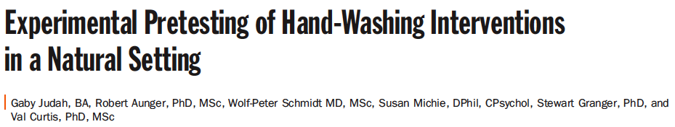
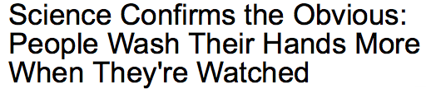
Isn’t Psychology just studying the obvious?
In a Journal:
In the news:
Notes:
What it actually was:
Wireless sensors measured entry into restrooms and soap dispenser use. Not actual people watching.
An electronic board above the sinks displayed either nothing or one of several different text messages aimed at different domains.
They found that men were more likely to wash their hands when a message designed to elicit disgust was shown: “Soap it off or eat it later” or “Don’t take the loo with you - wash with soap”.
Women on the other hand were more likely to wash their hands when a message designed to activate knowledge: “Wash your hands with soap”.

Slide 7
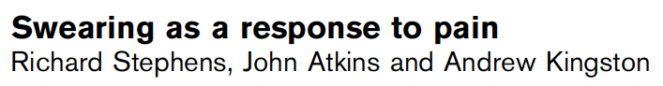
Isn’t Psychology just studying the obvious?
In a Journal:
Relying on intuition can lead to bias and errors
Notes:
Swearing alters individuals' experience of pain
This study investigated whether swearing affects cold-pressor pain tolerance (the ability to withstand immersing the hand in icy water), pain perception and heart rate.
In a repeated measures design, pain outcomes were assessed in participants asked to repeat a swear word versus a neutral word. In addition, sex differences and the roles of pain catastrophizing, fear of pain and trait anxiety were explored.
“Catastrophizing is an irrational thought a lot of us have in believing that something is far worse than it actually is.”
Swearing increased pain tolerance, increased heart rate and decreased perceived pain compared with not swearing. However, swearing did not increase pain tolerance in males with a tendency to catastrophize.
The observed pain-lessening (hypoalgesic) effect may occur because swearing induces a fight-or-flight response and nullifies the link between fear of pain and pain perception.

Slide 8
Hindsight Bias
Belief that an outcome was foreseeable (after it has occurred)
“Knew it all along” effect
Findings seem obvious once we know them, were once controversial
Why call it a bias?
The mind builds its current wisdom around what we have already been told. We are “biased” in favor of old information.
Example – “Cigarettes cause cancer”

Slide 9
A thought experiment: Tell one group of people that “psychologists have found that separation weakens romantic attraction.” Asked to imagine why this is true, what do you suppose people will say?
I already knew that! Common sense! Out of sight, out of mind!
Carried-on experiment: Tell another group of people that “psychologists have found that separation strengthens romantic attraction.” Asked to imagine why this is true, what will do you suppose people will say?
I already knew that! Common sense! Absence makes the heart grow fonder!

Slide 10
Overconfidence
Sometimes we think we know more than we actually know.
Anagram
WREAT
WATER
How long do you think it would take to unscramble these anagrams?
ETYRN
ENTRY
GRABE
BARGE
People said it would take about 10 seconds, yet on average they took about 3 minutes (Goranson, 1978).

Slide 11
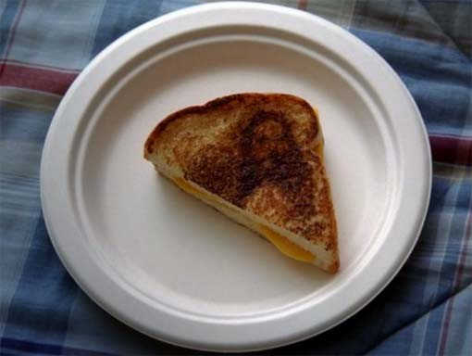
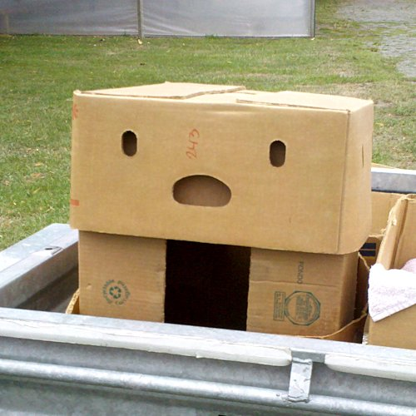
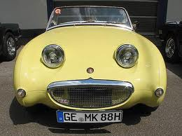
Perceiving Order in Random Events
People are naturally inclined to perceive patterns
E.g. objects with face-like properties activate same region of the brain as real faces

Slide 12
Perceiving Order in Random Events
We try to find order/patterns in random events
Participation Question: Which sequence of coin flips is statistically more likely?
H H H H H H
H T H T T H
They are both 50/50. But because one looks more “random”, that is perceived more likely.

Slide 13
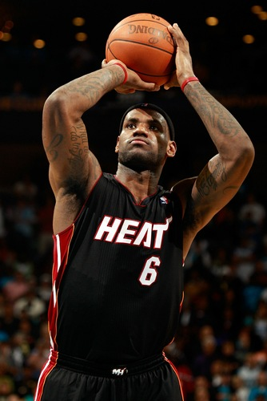
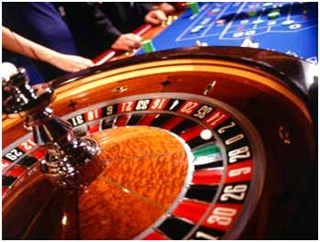
Perceiving Order in Random Events
Fallacies of randomness
Hot hand
“on a roll”, “hot streak”
Gambler’s fallacy
“bound to come up eventually,”
“it’s due”

Slide 14
The Scientific Attitude
Curiosity
Skepticism
Humility
Let’s take a closer look at each of these.

Slide 15
The Scientific Attitude
Curiosity
Includes a passion to explore and understand the world without misleading or being misled
Definition
Always asking new questions
“That behavior I’m noticing in that guy… is that common to all people? Or is it more common when under stress? Or only common for males?”

Slide 16
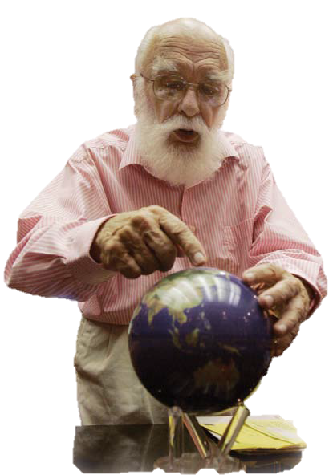
The Scientific Attitude
Skepticism
Supports questions about behavior and mental processes: What do you mean? How do you know?
Definition
Not accepting a “fact” as true without challenging it; seeing if “facts” can withstand attempts to disprove them
Skepticism, like curiosity, generates
questions: “Is there another explanation
for the behavior I’m seeing?
Is there a problem with how I measured
it, or how I set up my experiment?
Do I need to change my theory to fit
the evidence?
THE AMAZING RANDI: Magician and skeptic James Randi has tested and debunked a variety of psychic phenomena.

Slide 17
The Scientific Attitude
Humility
Involves awareness that mistakes are possible and willingness to be surprised
One of psychology’s early mottos: “The rat is always right.”
Definition
Seeking the truth rather than trying to be right; a scientist needs to be able to accept being wrong
“What matters is not my opinion or yours, but the truth nature reveals in response to our questions.”
David Myers

Slide 18
The Scientific Attitude
Thinking critically
Look for hidden assumptions and decide if you agree
Look for hidden bias, politics, values or personal connections
Put aside your own assumptions and biases and look at the evidence
See if there was a flaw in how the information was collected
Consider if there are other possible explanations for the facts or results
Critical thinking
Refers to a more careful style of forming and evaluating knowledge than simply using intuition.
In addition to the scientific method, critical thinking helps develop more effective and accurate ways to figure out what makes people do, think and feel the things they do.
Analyzing information to decide if it makes sense, rather than simply accepting it.
Goal: Getting at the truth even if it means putting aside your own ideas

Slide 19
CRITICAL THINKING: Analyzing, rather than simply accepting information
Determining if flaws in information collection exists
Considering alternative explanations for facts or results
Searching for hidden assumptions and deciding if you agree
Looking for hidden bias, politics, values or personal connections
Discarding personal assumptions and biases and viewing the evidence

Slide 20
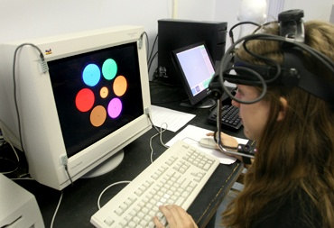
How Do Psychologists Ask and Answer Questions?
The Scientific Method

Slide 21
Theory – an explanation using an integrated set of principles that organizes observations.
Theory
Hypothesis – a testable prediction implied by a theory.
The testable can then be proved or disproved to come to a conclusion
Hypothesis

Slide 22
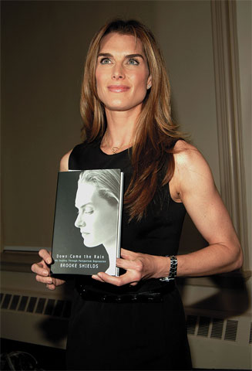
We might theorize that the cause of depression is low self-esteem - one’s feelings of self-worth.
We might hypothesize that depression and self-esteem will correlate negatively.
We might test this hypothesis by seeing if people who receive a low score for self-esteem tend to receive a high score for depression.

Slide 23
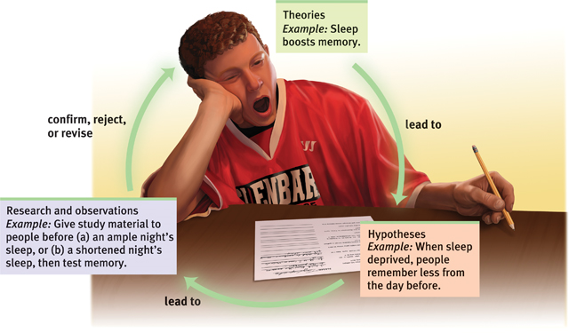
Research Process

Slide 24
How Do Psychologists Ask and Answer Questions?
Generating a research question

Slide 25
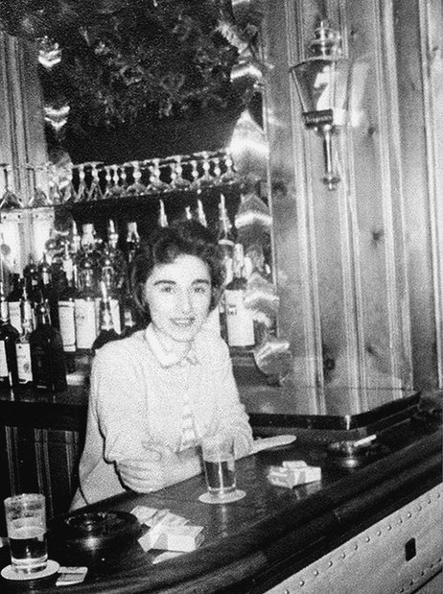
Generating a Research Question
Everyday observation – One source of research questions psychology is simply observing the world around you and asking questions about why people think and behave as they do.

Slide 26
Generating a Research Question
In the 1960s, social psychologists John Darley and Bibb Latane were horrified by the brutal murder of a woman named Kitty Genovese. It was widely reported that dozens of neighbors witnessed or were aware of the attack—but no one helped.
Notes:
Bystander Effect
A lot of psychological researched is started because of tragedy

Slide 27
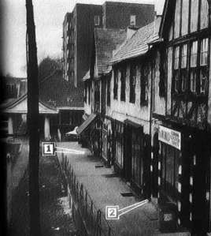
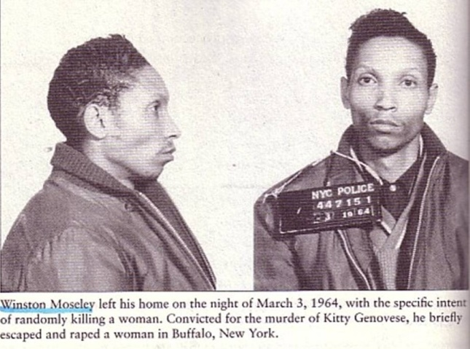
Generating a Research Question

Slide 28
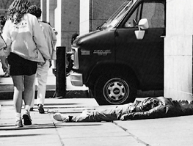
Generating a Research Question
Darley and Latane hypothesized that any given bystander is less likely to give aid to a victim if other bystanders are present. In a series of studies, Darley and Latane found that this is indeed the case.
http://www.youtube.com/watch_popup?v=JcowGVd6GqY&vq=medium

Slide 29
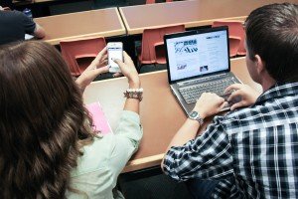
Generating a Research Question

Slide 30
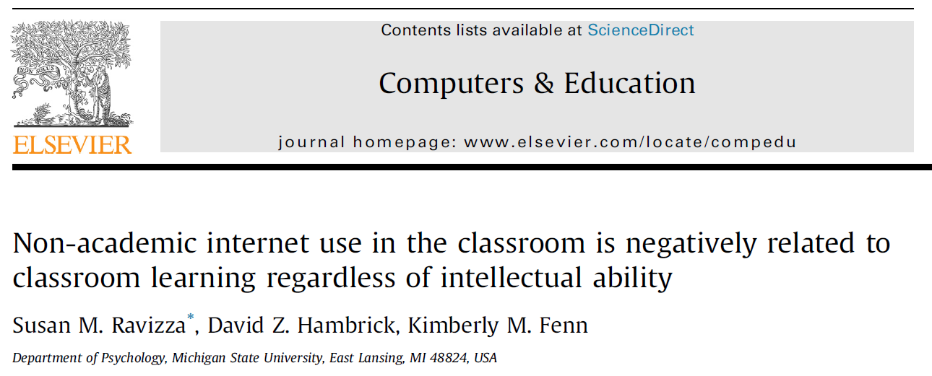
Generating a Research Question

Slide 31
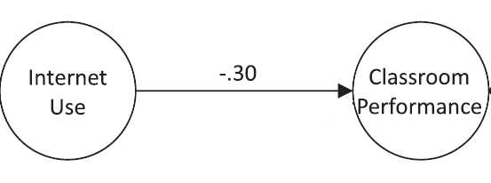
Generating a Research Question

Slide 32
Generating a Research Question
Replication – seeing whether a basic finding can be observed again with different participants and under different circumstances.

Slide 33
Generating a Research Question
After the original study of the bystander effect, there were dozens of follow-up studies aimed at answering specific questions about the effect.

Slide 34
How Do Psychologists Ask and Answer Questions?
Establishing operational definitions

Slide 35
How Do Psychologists Ask and Answer Questions?
Choosing a research design

Slide 36
Choosing a Research Design
Three major types of research designs that psychologists use in their research…
Setting
Lab
Field
Descriptive
Methods
Correlational
Experimental

Slide 37
Descriptive Methods
The Case Study – an in-depth investigation of a single (or very few) subjects

Slide 38
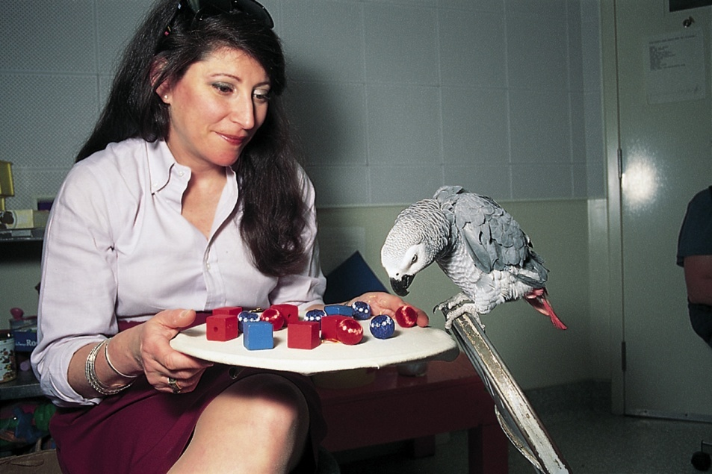
The Case Study
Through a 30-year case study, Irene Pepperberg concluded that African Grey parrot Alex could name and categorize objects, and comprehend numbers up to six.
http://www.youtube.com/watch?v=7yGOgs_UlEc

Slide 39
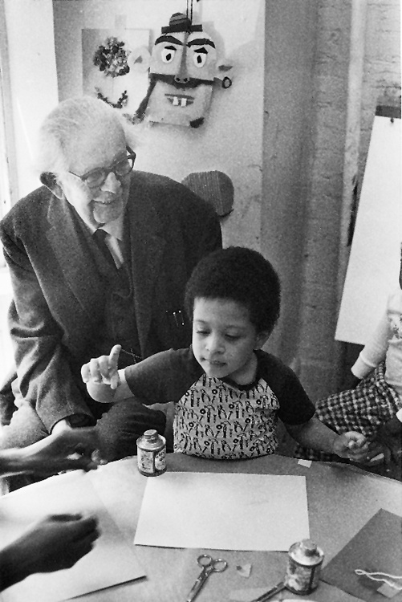
The Case Study
Through a series of case studies, often of his own children, Jean Piaget developed an influential theory of cognitive development, which assumes that cognitive functions unfold through a series of distinct stages.

Slide 40
Descriptive Methods
The Survey – an investigation of many cases in less depth by asking people to report opinions and behaviors

Slide 41
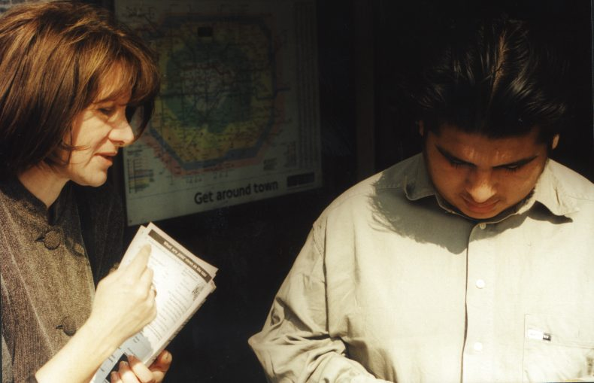
The Survey
A technique for ascertaining the self-reported attitudes, opinions or behaviors of people usually done by questioning a representative sample of people—one that accurately portrays the population of interest.

Slide 42
Descriptive Methods
Naturalistic Observation – recording behavior in its natural environments, and describing it in detail

Slide 43
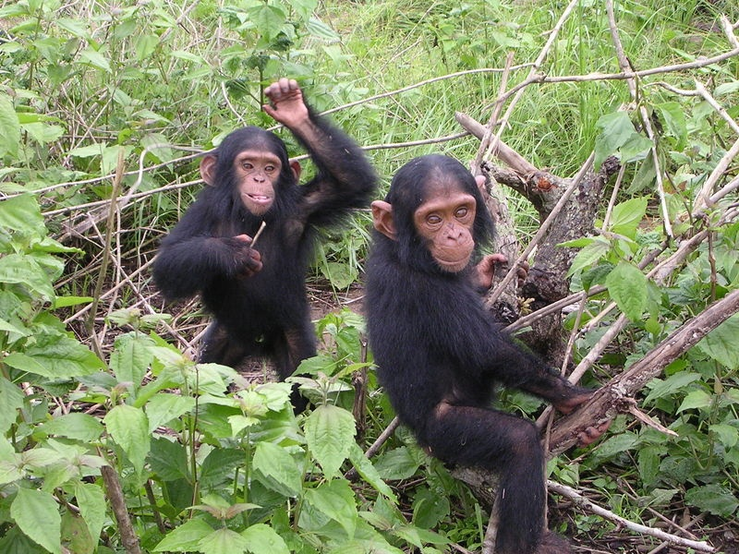
Naturalistic Observation
Primatologist Jane Goodall used naturalistic observation to study chimpanzees. She concluded, “Observations, made in the natural habitat, helped to show that the societies and behavior of animals are far more complex than previously supposed.”
Credit: Delphine Bruyere

Slide 44
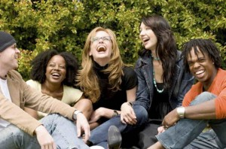
Naturalistic Observation
Psychologists have used naturalistic observation to study, effects of social interaction on people’s behavior. One study found that people laugh 30 times more often in social situations than in solitary situations (Provine, 2001).

Slide 45
Experimental Methods
Purpose is to explore cause and effect by manipulating one or more factors, while holding other factors constant

Slide 46
Independent and Dependent Variables
Variable – anything that can fluctuate. Whether it’s rainy or sunny, warm or cold, or whether a person is male or female, or in a good mood or a bad mood, are all examples.

Slide 47
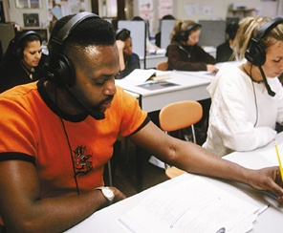
Independent and Dependent Variables
Independent variable – aspect of the situation or of individuals that can vary independently of other variables. The variables whose effect is being studied.
e.g. Online vs. Classroom

Slide 48
Independent and Dependent Variables
Dependent variable – the variable that may change in response to manipulations of the independent variable.
Score on Test

Slide 49
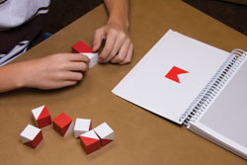
Establishing Operational Definitions
Operational definition – a specific statement of the procedures used to define research variables, so as to allow others to replicate the original observations.

Slide 50
Establishing Operational Definitions
An operational definition of intelligence might be the number correct on tests of verbal, spatial, numerical, and reasoning abilities.

Slide 51

Independent and Dependent Variables
An Example: Does breastfeeding children have an impact on their intelligence later in life?

Slide 52
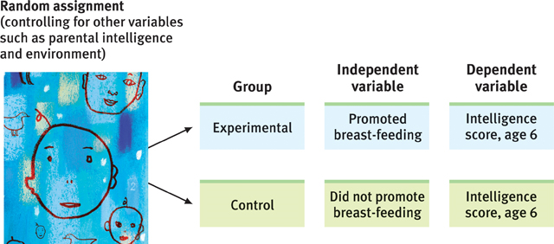
Independent and Dependent Variables
The independent variable is whether mothers are assigned to an experimental condition in which their children breast feed, or to a control condition in which they feed their children formula.

Slide 53
Independent and Dependent Variables
The dependent variable is the child’s score on an intelligence test at age 6. (This is the measureable aspect of psychological functioning that we think may be influenced by the independent variable.)

Slide 54
Random Assignment
Random assignment – assigning participants to experimental and control groups by chance, thus minimizing preexisting differences between the groups that could affect the dependent variable (e.g., SES).

Slide 55
Cause
Effect

Slide 56
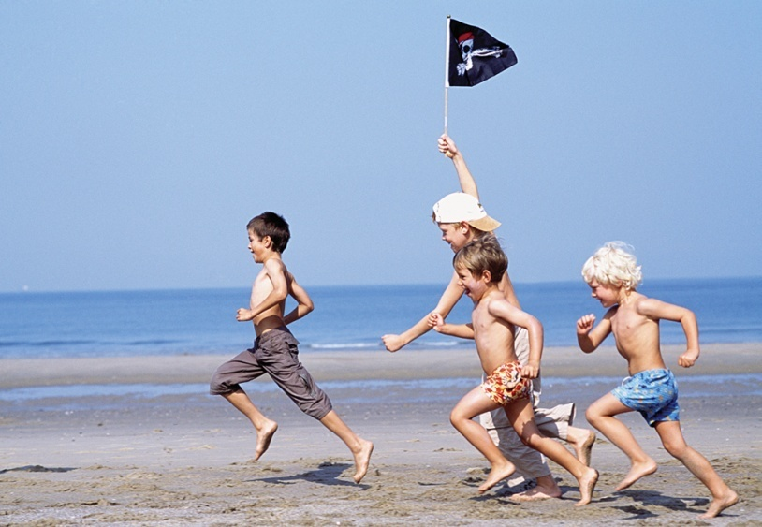
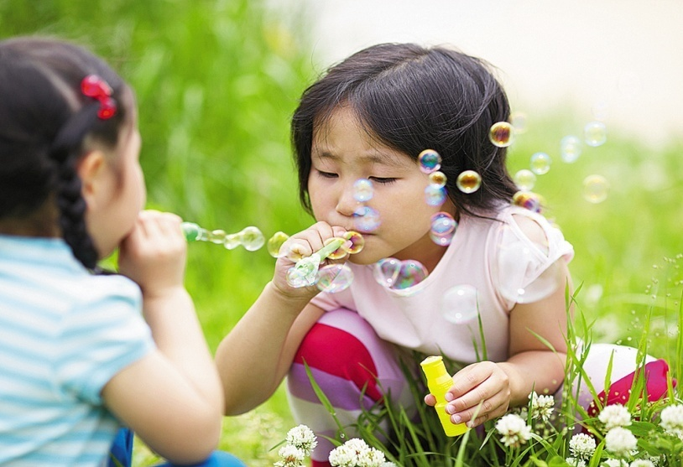
Sometimes it’s not possible to conduct an experiment. For example, it isn’t possible to assign a child to be male or female for the purpose of an experiment.

Slide 57
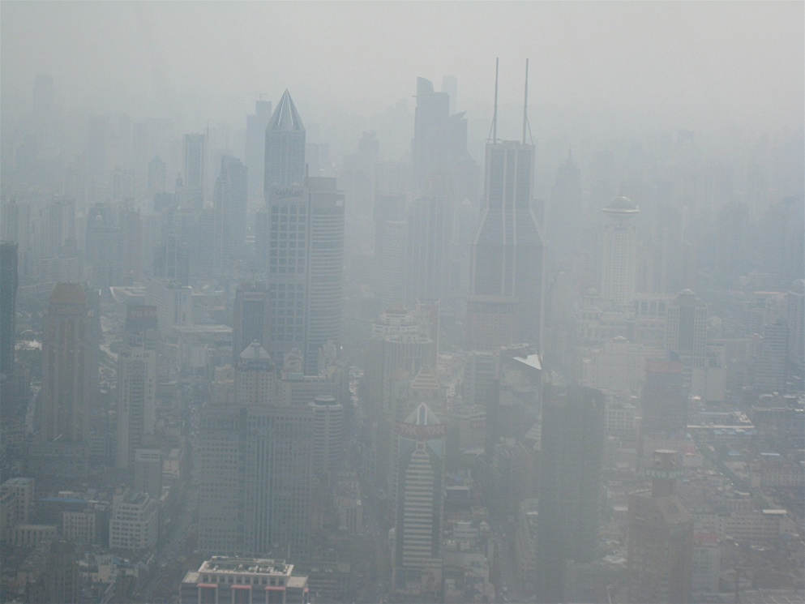
Other times, it’s unethical to conduct an experiment. For example, it would be unethical to assign people to be exposed to polluted air or non-polluted air for the purpose of seeing whether pollution has a negative effect on mental functioning.

Slide 58
Correlational Methods
Purpose is to observe naturally occurring relationships between variables

Slide 59
Correlational Methods
Correlation coefficient – a statistical index (-1 to 1) of the relationship between two variables

Slide 60
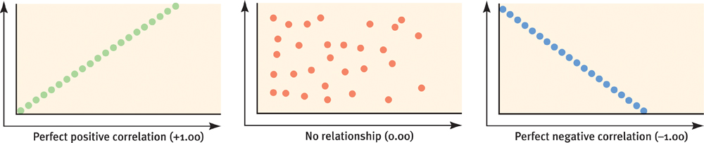
Scatterplot – a graphed cluster of dots, each of which represents the values of two variables. The slope of the points suggests the direction of the relationship, while the amount of scatter suggests the strength of the relationship.

Slide 61
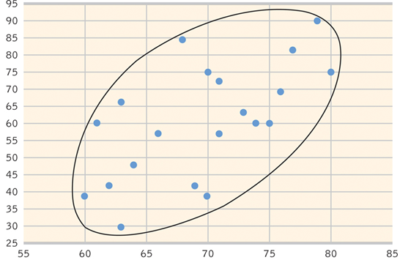
Test Score
Time Spent Studying

Slide 62
Correlation and Causation
We might theorize that the cause of depression is low self-esteem—one’s feelings of self-worth.

Slide 63
Correlation and Causation
We might hypothesize that depression and self-esteem will correlate negatively.

Slide 64
Correlation and Causation
We might test this hypothesis by seeing if people who receive a low score for self-esteem tend to receive a high score for depression.

Slide 65
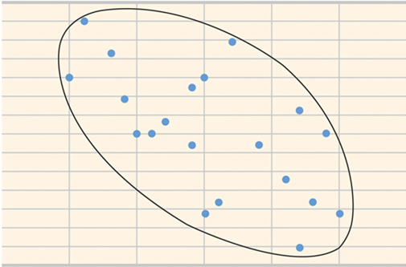
Correlation and Causation
30
25
20
15
10
5
0
Depression
0 5 10 15 20 25 30
Self Esteem

Slide 66
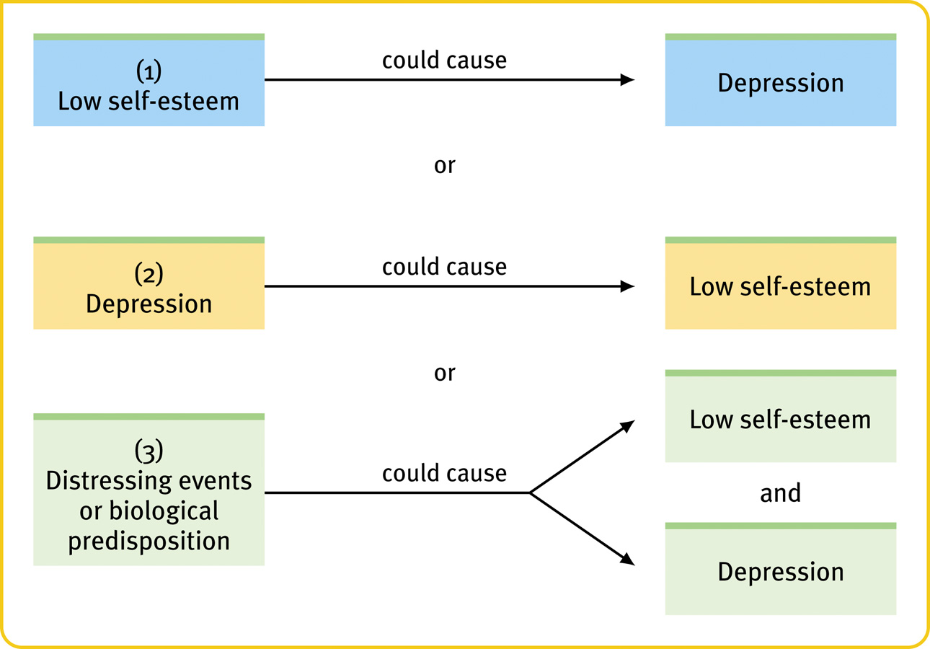
Correlation and Causation
or

Slide 67
Correlation and Causation
Correlation does not mean causation!
or

Slide 68
Correlation and Causation
or

Slide 69
Testing Hypotheses: Correlational Methods
In the media:
Keeping a food diary doubles diet weight loss
Teen use of pot can lead to dependency, mental illness
Church attendance boosts immunity
Ice cream leads to murder
Notes:
FOOD DIARY. The findings, from one of the largest and longest running weight loss maintenance trials ever conducted…"Those who kept daily food records lost twice as much weight as those who kept no records. It seems that the simple act of writing down what you eat encourages people to consume fewer calories.”
POT: A teen who has been depressed at some point in the past year is more than twice as likely to have used marijuana as teens who have not reported being depressed - 25 percent compared with 12 percent,… using marijuana increases the risk of developing mental disorders by 40 percent, the report said. And teens who smoke pot at least once a month over a yearlong period are three times more likely to have suicidal thoughts than nonusers, it said.
CHURCH: Blood tests showed that regular attendees were less likely to have high levels of an immune-system protein involved in age-related diseases. Earlier studies found a correlation between religious observation and good physical health, but it wasn’t clear if healthy individuals simply get to church regularly or if church attendance itself delays a decline in physical well-being.
EGG” He said the study fails to take exercise or other dietary habits into account. Study participants could have consumed more salt, or they could have been on cholesterol-reducing drugs, too.
“It may be that people who consume a lot of eggs also consume a lot of other fatty foods,” Frid said, adding that how the egg is prepared should also be taken into account.
Ask: why do we bother with them at all if it is a causal relationship that we seek? Why not just gather data that could provide a more definite answer, or otherwise just ignore correlations? The reason is pragmatism. Correlational data are usually relatively easy and inexpensive to obtain, at least in comparison to experimental data. Also, many cause-effect relationships are so subtle that we often first learn of them through correlations detected in observational data. That is, they are often useful.

Slide 70
